Slide 1

Dynamic Level Generation
By:
Ayush Singh
Himanshu Singh
Karthik Sagar
Shabbir Habib
Shagun Bhatia
Shubhankar Singh
Vikas Nyamati

Slide 2
About the Project
When playing games, players often begin with different skill levels and gradually develop their skills, making even the best designed games difficult for some and easy for others.
To combat this challenge, we present a proposed solution. Dynamic Level Generation is a general category of approaches focusing on basic parameter tweaking, which, in response to player performance, alters games during play.

Slide 3
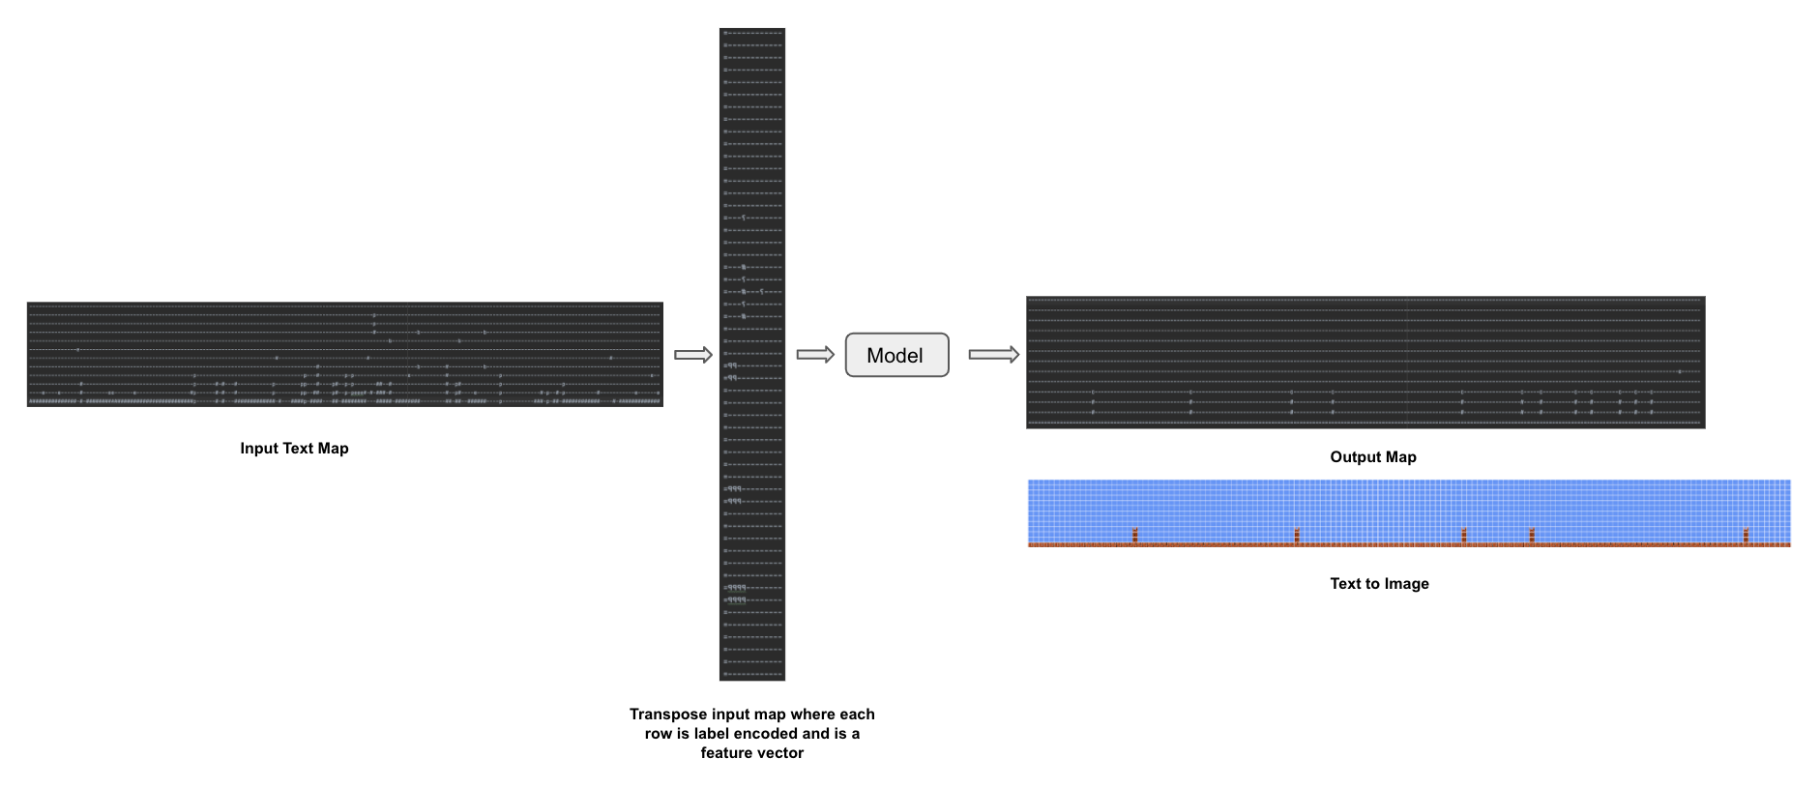
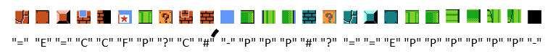
General Workflow

Slide 4
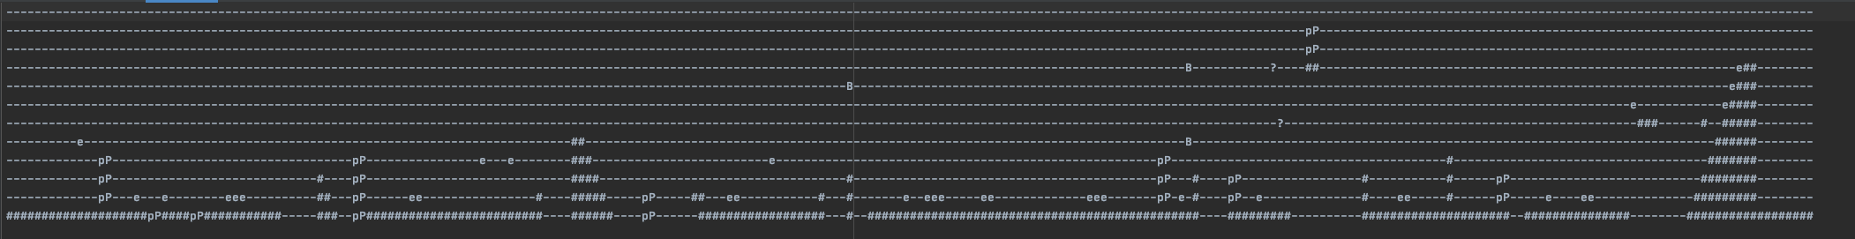
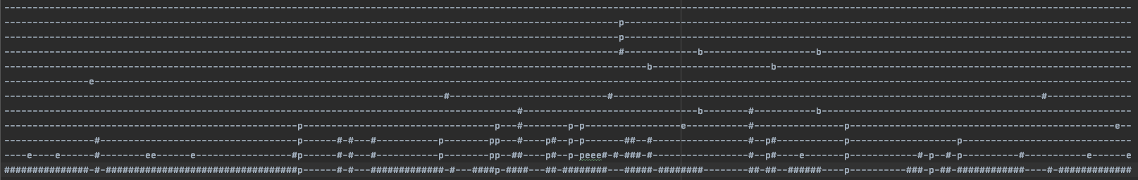
Sample Input and output

Slide 5
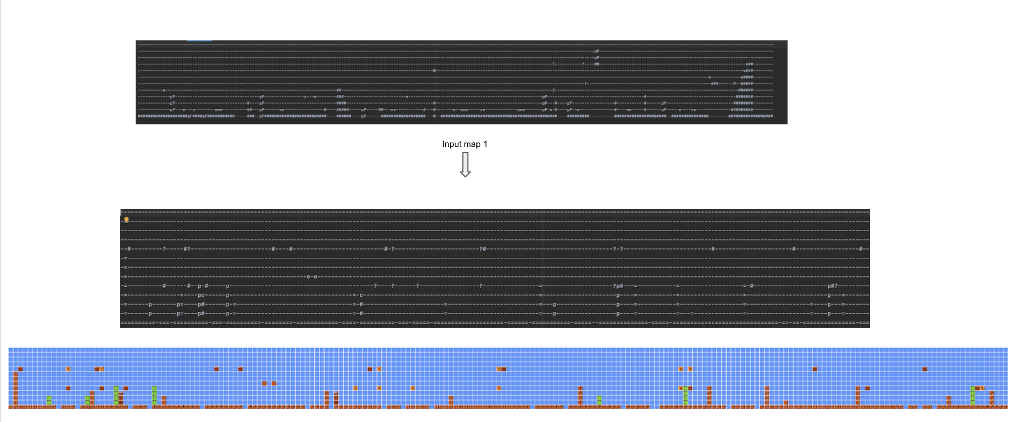
Hidden Markov Model

Slide 6
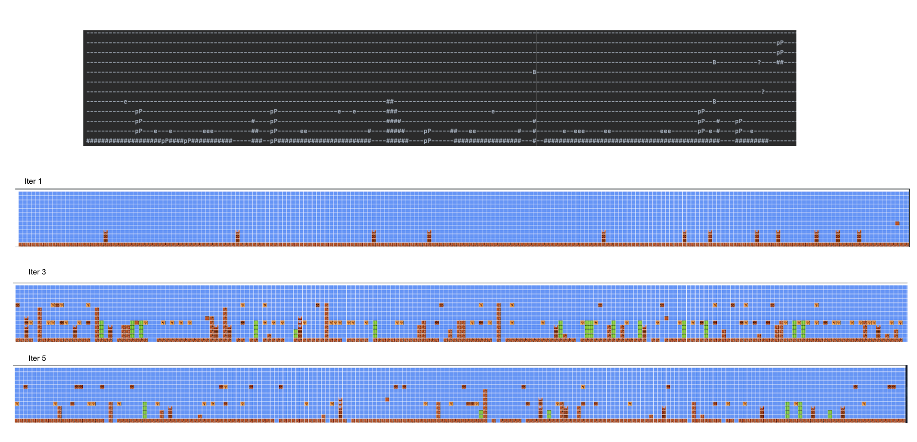
LSTM

Slide 7
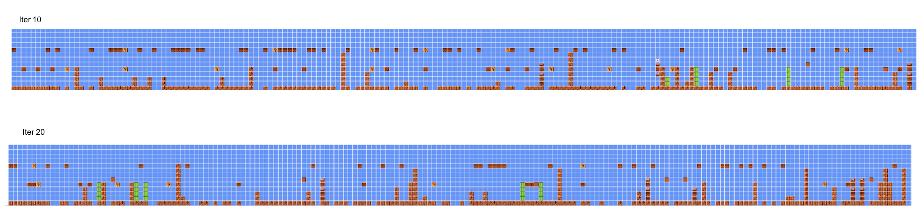

Slide 8
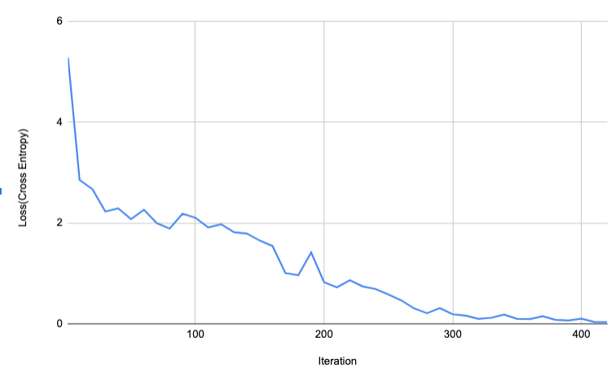
LSTM training graph

Slide 9
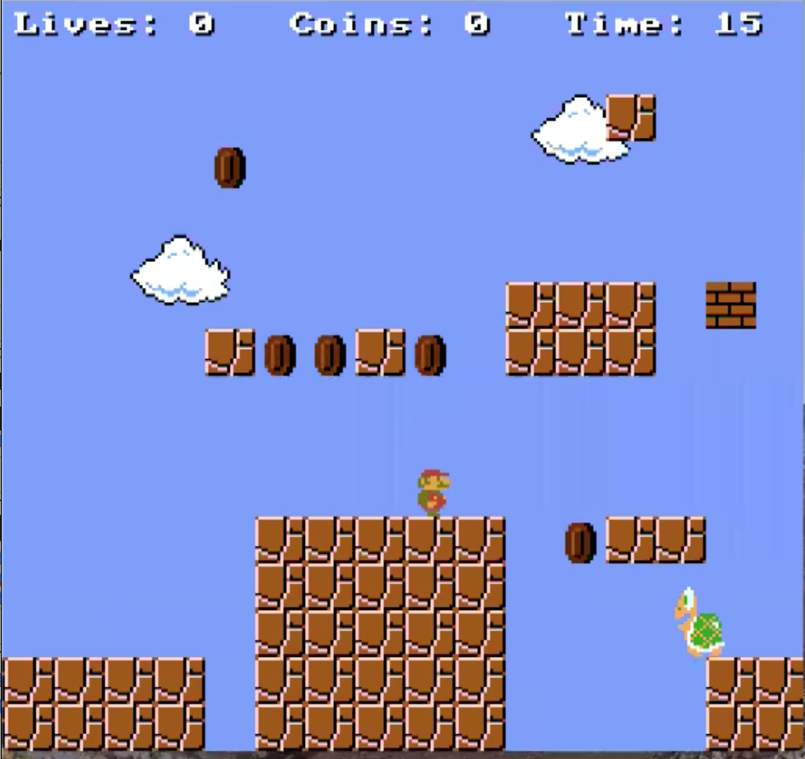
Super Mario bot

Slide 10
Sample Data
Easy Dataset
Medium Dataset
Total Data Set
Hard Dataset

Slide 11
Category classification criteria
Category classification ∝ Completion
Category classification ∝ Number of Coins
Category classification ∝ ( 1 / Number of Jumps )
Category classification ∝ ( 1 / Remaining time )
Category classification ∝ ( 1 / Number of Kills )

Slide 12

Easy Mode

Slide 13
Easy Mode
 |  |  |  |  | Total kills
Map Number | Status | Completion % | Coins | Remaining Time | Stomps | Fireballs | Shells | Falls | Bricks | Jumps
1 | WIN | 1 | 1 | 7 | 3 | 0 | 0 | 2 | 0 | 14
2 | WIN | 1 | 1 | 6 | 1 | 0 | 0 | 0 | 0 | 17
3 | WIN | 1 | 2 | 8 | 4 | 0 | 0 | 0 | 0 | 12
4 | WIN | 1 | 1 | 8 | 1 | 0 | 0 | 1 | 0 | 13
5 | WIN | 1 | 0 | 5 | 0 | 0 | 0 | 0 | 0 | 19

Slide 14
Medium Mode

Slide 15
Medium Mode
 |  |  |  |  | Total kills
Map Number | Status | Completion % | Coins | Remaining Time | Stomps | Fireballs | Shells | Falls | Bricks | Jumps
1 | WIN | 1 | 0 | 8 | 2 | 0 | 0 | 1 | 0 | 13
2 | WIN | 1 | 0 | 8 | 2 | 0 | 0 | 2 | 0 | 13
3 | WIN | 1 | 0 | 8 | 1 | 0 | 0 | 0 | 0 | 12
4 | LOSE | 0.8 | 1 | 10 | 0 | 0 | 0 | 0 | 0 | 9
5 | LOSE | 0.6 | 3 | 11 | 1 | 0 | 0 | 2 | 0 | 7

Slide 16
Hard Mode

Slide 17
Hard Mode
 |  |  |  |  | Total kills
Map Number | Status | Completion % | Coins | Remaining Time | Stomps | Fireballs | Shells | Falls | Bricks | Jumps
1 | LOSE | 0.1 | 0 | 14 | 0 | 0 | 0 | 0 | 0 | 1
2 | LOSE | 0.5 | 0 | 11 | 0 | 0 | 0 | 0 | 0 | 8
3 | LOSE | 0.5 | 0 | 12 | 0 | 0 | 0 | 0 | 0 | 6
4 | WIN | 1 | 0 | 9 | 2 | 0 | 0 | 0 | 0 | 11
5 | LOSE | 0.1 | 0 | 15 | 0 | 0 | 0 | 0 | 0 | 1

Slide 18
Adaptive Mode

Slide 19
Adaptive Mode
 |  |  |  |  |  |  | Total kills
Map Number | SET |  | Status | Completion % | Coins | Remaining Time | Stomps | Fireballs | Shells | Falls | Bricks | Jumps
1 | Generated |  | WIN | 1 | 4 | 7 | 2 | 0 | 0 | 1 | 0 | 17
2 | Generated |  | LOSE | 0.2 | 0 | 14 | 0 | 0 | 0 | 0 | 0 | 3
3 | Generated |  | LOSE | 0.1 | 0 | 14 | 0 | 0 | 0 | 0 | 0 | 1
4 | Generated |  | WIN | 1 | 0 | 6 | 0 | 0 | 0 | 0 | 0 | 14
5 | Generated |  | WIN | 1 | 0 | 6 | 0 | 0 | 0 | 0 | 0 | 9
6 | Generated |  | LOSE | 0.1 | 0 | 15 | 0 | 0 | 0 | 0 | 0 | 1
7 | Generated |  | WIN | 1 | 0 | 6 | 0 | 0 | 0 | 0 | 0 | 11
8 | Generated |  | TIMEOUT | 0.9 | 3 | 0 | 11 | 0 | 0 | 0 | 0 | 21
9 | Generated |  | TIMEOUT | 0.9 | 0 | 0 | 0 | 0 | 0 | 0 | 0 | 30
10 | Generated |  | WIN | 1 | 0 | 6 | 1 | 0 | 0 | 0 | 0 | 10
11 | Generated |  | WIN | 1 | 0 | 6 | 0 | 0 | 0 | 0 | 0 | 14

Slide 20

Thank You

